Slide 1

LIBRARY MANAGEMENT SYSTEM Project Synopsis Presentation Date: 19/09/2017
Course Name (Course Code)
Degree : B.Tech (CSE)
PROJECT GUIDE:
Miss. LUCKY RAJPOOT
SUBMITTED BY:-
SANGEETA KUMARI MAHATO(TCA1509083)
COLLEGE OF COMPUTING SCIENCES AND INFORMATION TECHNOLOGY
TEERTHANKER MAHAVEER UNIVERSITY, MORADABAD

Slide 2

Project Brief
LIBRARY MANAGEMENT SYSTEM
In this admin can add/delete/view and librarian can add/view books, issue/ view issued books and return books and keep the records of these actions.
Library Management System allows the user to store the book details and the customer details.
The online library management system is designed with the purpose of reducing paper work of the Library by transforming it into digital work
It saves time.Manual work requires more time, more energy to complete and it is very difficult to main previous records of the books.
2
T002/ Version 1.0

Slide 3
Technologies
Project platform- Notepad++
project Domain- window based Application.
operating system- windows 10
Tools- Notepad++ ,Command prompt , SQL data base.
3
T002/ Version 1.0

Slide 4
Tools to be used
Tools | vendor | Version
Notepad++ | Don Ho | 2.1.1
Command prompt
My SQL | Oracle | 2013
4
T002/ Version 1.0

Slide 5
Project Modules
This project is divided into 2 different modules; 1. Admin Add books View Books Update Books
Place Books
2. Student
Add Books
View Books
Search Books
Returns Books
5
T002/ Version 1.0

Slide 6
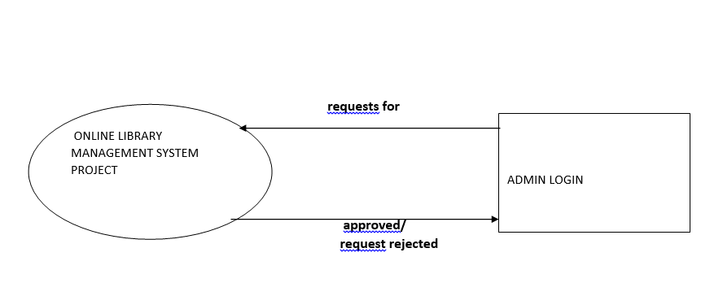
l
Data Flow Diagram (DFD)
6
T002/ Version 1.0

Slide 7
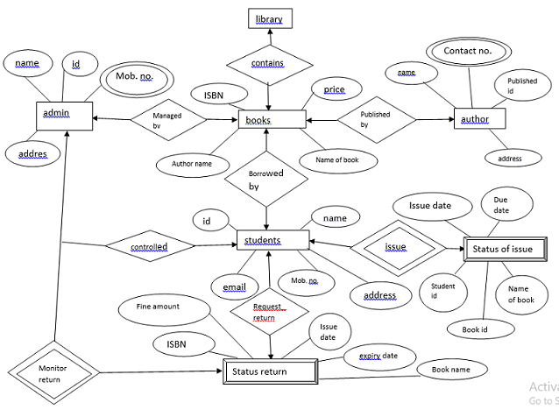
Entity Relationship Diagram (ERD)
7
T002/ Version 1.0

Slide 8
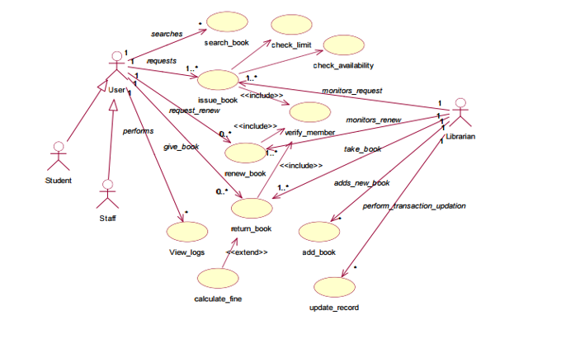
Use Case Diagram
8
T002/ Version 1.0

Slide 9
Advantage of The Project
Reduces paper work
It is digital based . Facilities that are provided to switch their record keeping systems which are able to dramatically cut their spending in different ways.
2. Higher security and compliance
Manual documents can be lost or damaged because of fires, flooding or other types of natural disasters and accidents. In spite of it digital files benefit from redundant storage features and disaster recovery solutions. Even if one server fails, digital backups of every document exist. In this way, records are more secure.
9
T002/ Version 1.0

Slide 10
References, if any
www.google.com
Some java books
Youtube
10
T002/ Version 1.0

Slide 11
THANKS

